Slide 1
Election Data Visualization for Media

Slide 2
The Challenge
Elections generate massive amounts of raw data—from voter turnout and party performance to complex demographic shifts. For media organizations, the challenge lies in processing this "noise" quickly and accurately so the public can understand the results in real-time.
The Solution
This project provides a robust framework that transforms complex electoral datasets into actionable visual intelligence. Using a technical stack centered on Power BI and interactive web technologies, the system:
Organizes diverse data inputs, including candidate statistics and gender-wise voter demographics.
Visualizes trends through dynamic dashboards, comparative charts, and longitudinal (historical) analysis.
Simplifies winning margins and party swings into clear, interactive visual stories.

Slide 3
Objectives
The objective for the project is as follows:
1 To collect and organize the election related data
2 To visualize election statistics using charts and graphs.
3 To analyze voter turnout and demographic patterns.
4 To display party and candidate performance.
5 To help media present election data clearly.

Slide 4
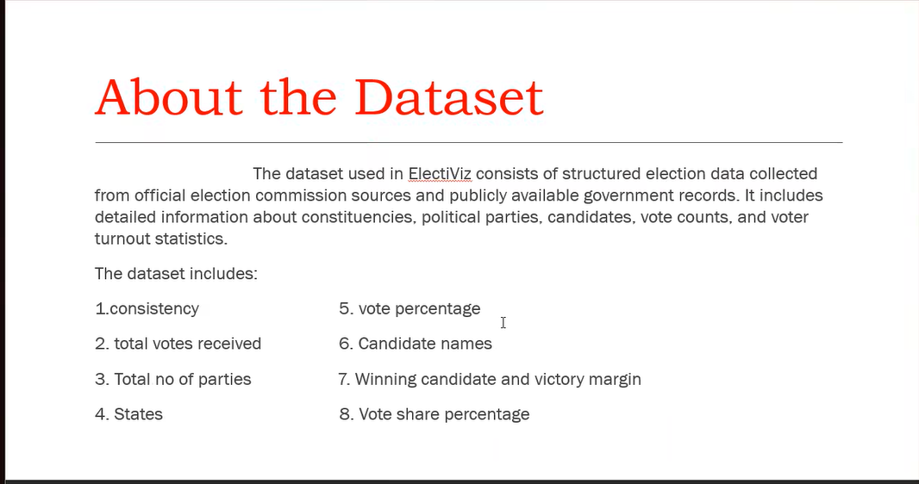

Slide 5
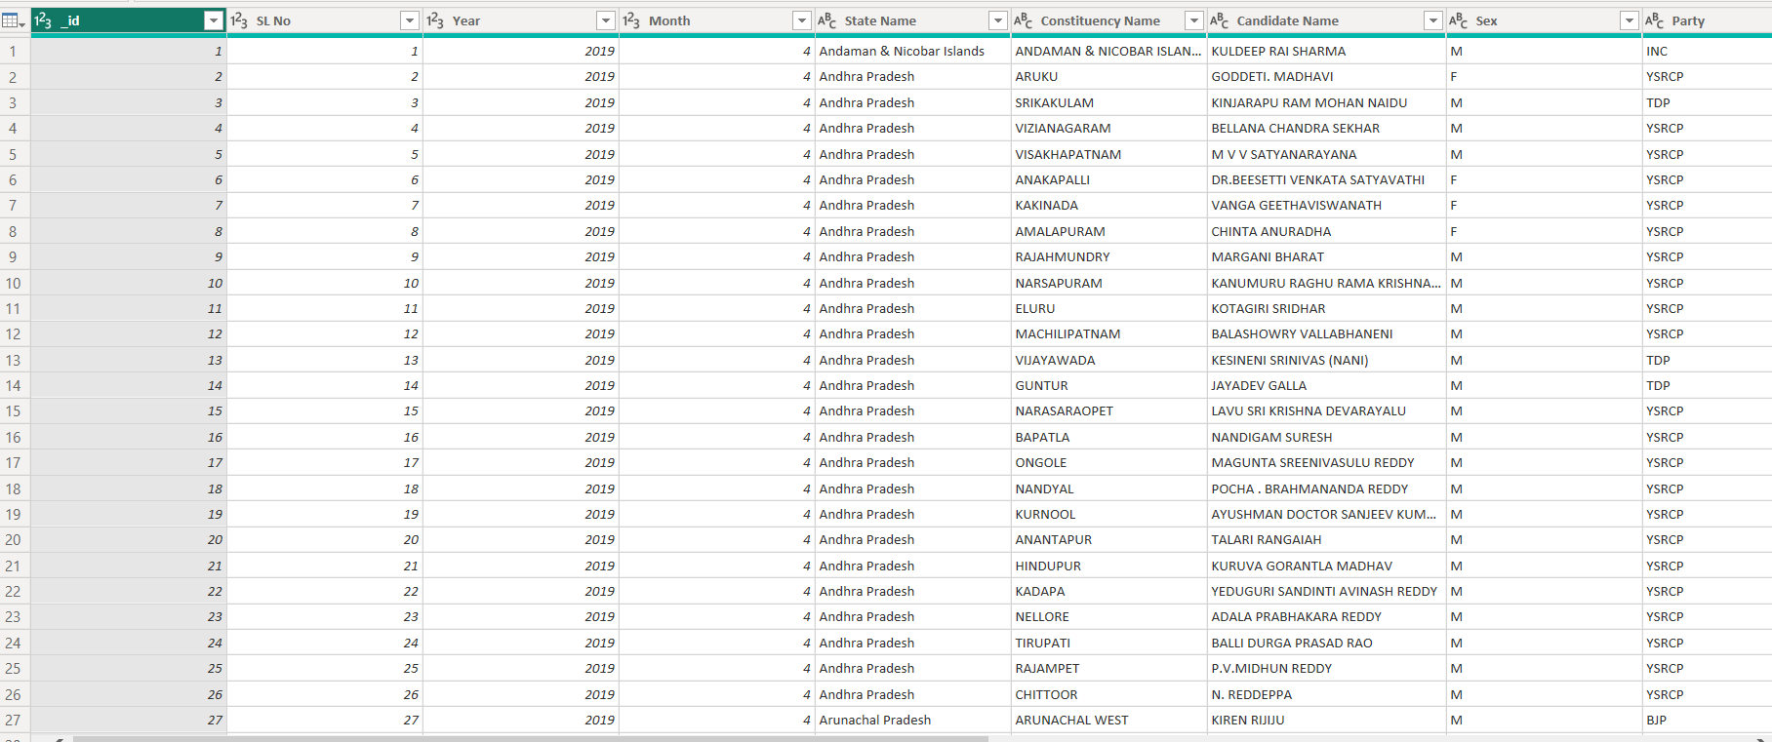
DataSet Description The dataset description is about the data fields which are used for the project such as candidate name, candidate party, state, Total number of votes, winning margin, state, constituency, male and female percentage of voters, election year etc.

Slide 6
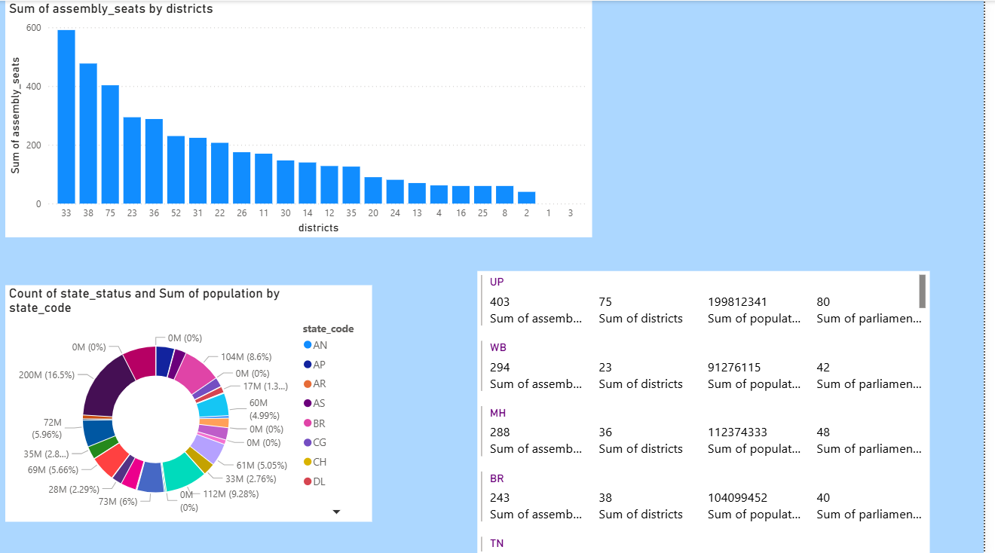
Task 1 : Data Integrations and Modelling:

Slide 7
1. Top Bar Chart: Sum of Assembly Seats by Districts
This chart visualizes the distribution of assembly seats across different groupings of districts.
X-Axis: Districts (represented by numerical identifiers/counts per state).
Y-Axis: Sum of assembly_seats.
Key Observations:
The chart shows a steady decline, with district groups 1 and 3 showing negligible seat counts.
2. Bottom-Left Donut Chart: Population Distribution by State Code
This chart visualizes the Sum of population and Count of state_status categorized by state_code.
Metric: Total Population (represented in Millions/M) and Percentage of Total.
73M (6%): and 72M (5.96%): Mid-sized population states.
3. Right-Side Data List: State-Wise Summary
This section provides a tabular/list view of specific metrics per state.

Slide 8
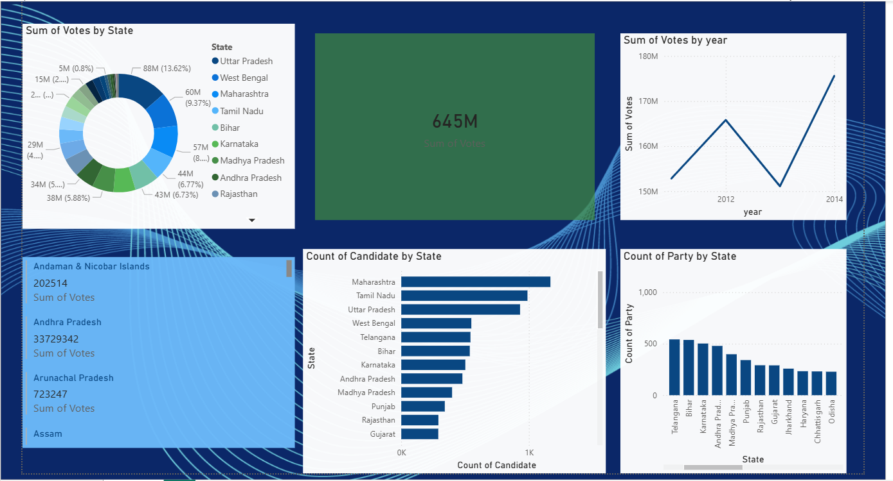
Task 2: Historical Trends

Slide 9
Here is a breakdown of the specific cards used across your Power BI reports:
1. KPI (Key Performance Indicator) Cards
These large, single-value callouts anchor your dashboards by highlighting the most significant electoral totals.
Total Votes Polled: A primary card showing a massive 645M total votes.
Total Electors: Displays a high-level count of 55bn electors.
2. Focus & Identity Cards
These cards are used to dynamically display text-based information, such as specific candidate or party names, based on dashboard filters.
3. Multi-Row & List Cards
These cards group multiple related data points into a structured list, often used in sidebars for regional deep-dives.
Regional Summary List: Lists state-wise vote counts, such as:
Detailed Performance List: Combines State Name, Party, and Winning Margin (e.g., Assam, INC, 0.68) into a single vertical layout for easy comparison.

Slide 10
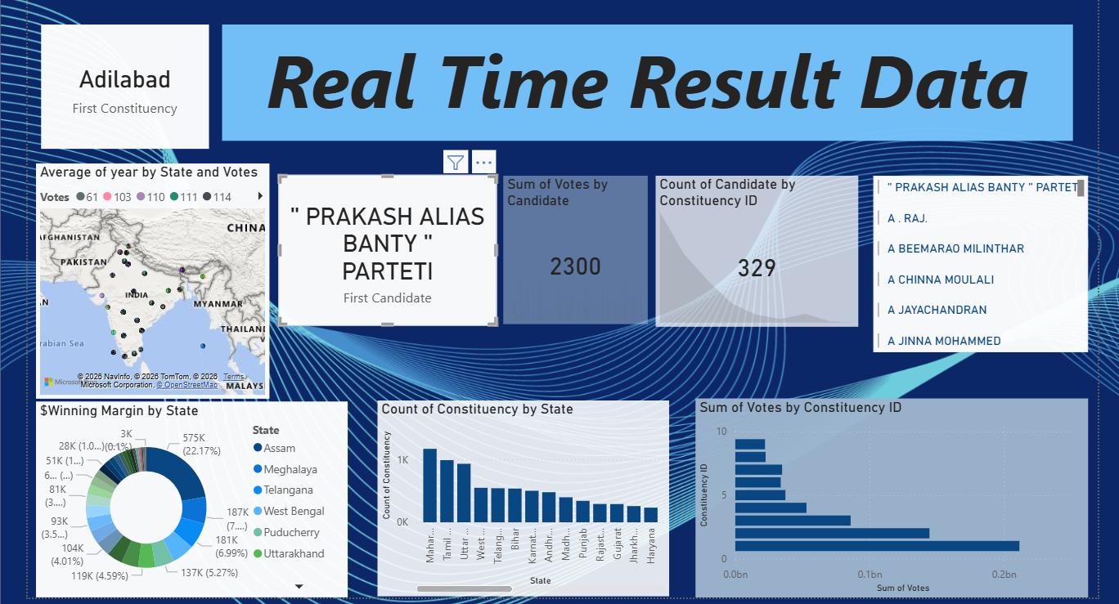
Task 3: Realtime Results

Slide 11
The specific cards and visual metrics identified in your dashboard include:
1. KPI (Key Performance Indicator) Cards
These large, single-value callouts are used to anchor the dashboard with the most significant data points.Total Votes Polled:
Focus Card: A specialized card used to highlight a single individual, such as "PRAKASH ALIAS BANTY" PARTETI.Quick Count Cards: Small cards showing specific totals like 329 for the Count of Candidate by Constituency ID or 245 for the Sum of ac_no by ac_name
.2. Multi-Row or List CardsThe sidebar on the left side of your main dashboard functions as a list-style card system.Regional Summary Cards: These cards display a combination of text and numbers for specific regions to provide granular details without cluttering the main visual area
3. Comparative Summary Cards (Grid View)In the State-Wise Summary table, which functions like a grid of cards, several key measures are modeled together for direct comparison:
4. Donut Chart Legends (Category Cards)While part of the donut chart visuals, the legends act as category cards that represent critical distributions:Population

Slide 12
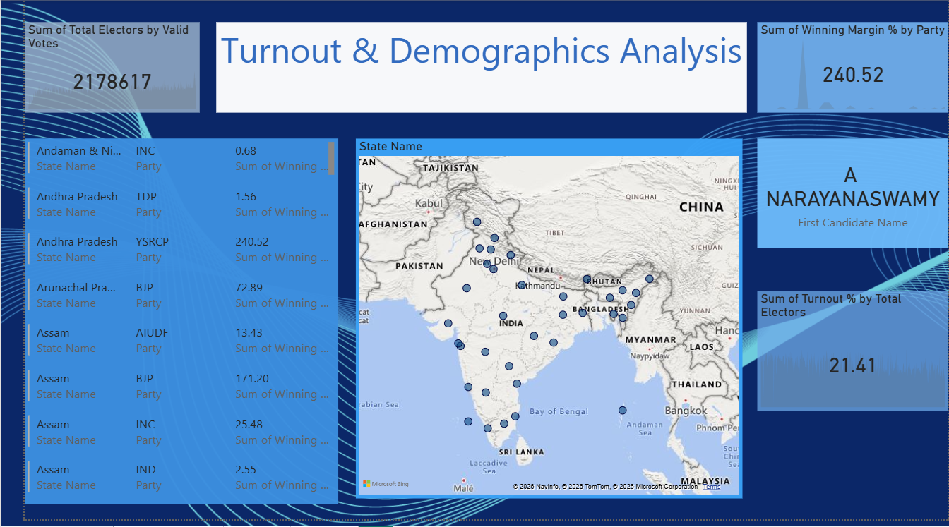
Task 4: Turnout and demographic analysis

Slide 13
1. Single Value (KPI) Cards
These cards are used to anchor the dashboard with essential, large-scale figures.
Total Votes Polled: Displays a central metric of 645M total votes.
Total Electors: Shows a high-level count of 55bn electors.
Constituency/AC Metrics: Smaller KPI cards show specific counts such as 245 for Sum of ac_no by ac_name.
Specific Candidate/State Data: Cards are used to highlight individual candidates like "PRAKASH ALIAS BANTY" PARTETI or winning margins such as 240.52 for specific parties.
2. Multi-Row Cards
These cards group related data points together, providing a structured list view for granular regional details.
State-Wise Summaries: Used in sidebars to list multiple metrics for states/UTs, such as:
Andaman & Nicobar Islands: 202,514 votes.
Andhra Pradesh: 33,729,342 votes.

Slide 14
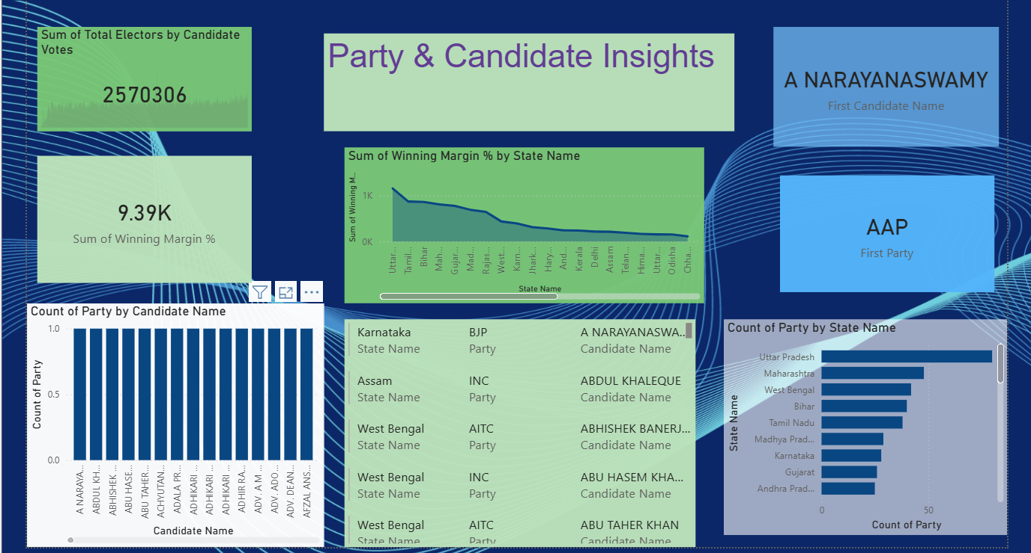
Task 5: Party and candidate performance

Slide 15
1. KPI (Key Performance Indicator) Cards
These large, single-value callouts anchor your dashboards by highlighting the most significant electoral totals.
Total Votes Polled: A primary card showing a massive 645M total votes.
Total Electors: Displays a high-level count of 55bn electors.
Sum of AC Numbers: Shows a specific total of 245 for Sum of ac_no by ac_name.
Total Electors by Candidate Votes: A specialized card showing 2,570,306 for focused candidate analysis.
Winning Margin %: Displays an aggregated percentage, such as 9.39K or 240.52, to highlight party performance.
2. Focus & Identity Cards
These cards are used to dynamically display text-based information, such as specific candidate or party names, based on dashboard filters.
Candidate Name Card: Highlights individual candidates like "PRAKASH ALIAS BANTY" PARTETI or A NARAYANASWAMY.

Slide 16
Party Name Card: Identifies a specific political group, such as AAP or ASP.
3. Multi-Row & List Cards
These cards group multiple related data points into a structured list, often used in sidebars for regional deep-dives.
Regional Summary List: Lists state-wise vote counts, such as:
Andaman & Nicobar Islands: 202,514.
Andhra Pradesh: 33,729,342.
Arunachal Pradesh: 723,247.
Detailed Performance List: Combines State Name, Party, and Winning Margin (e.g., Assam, INC, 0.68) into a single vertical layout for easy comparison.
Technical Implementation
These visuals are powered by the Data Integration and Modeling performed in Task-1:
Calculations: The values are derived from SUM and COUNT aggregations on cleaned fields like totvotpoll (total

